Slide 1
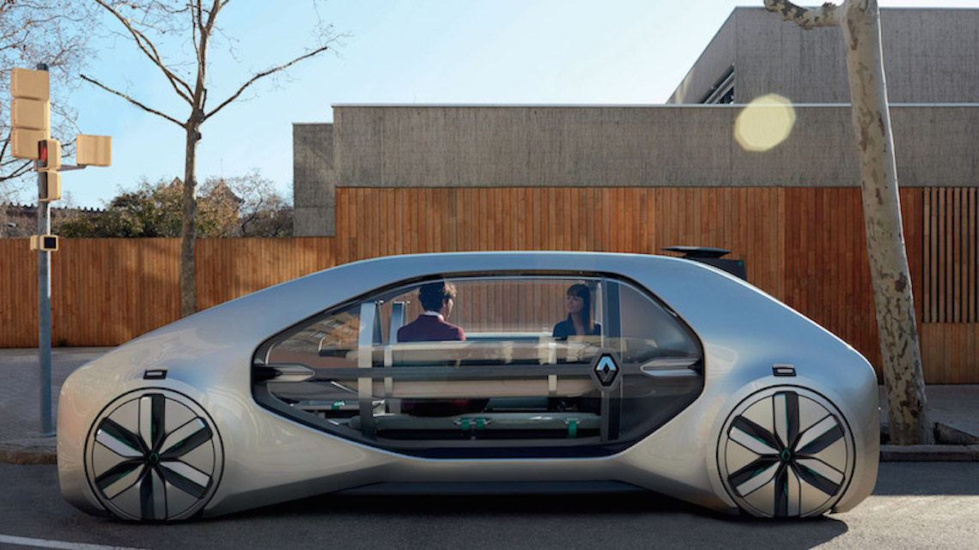
Self Driving Car

Slide 2
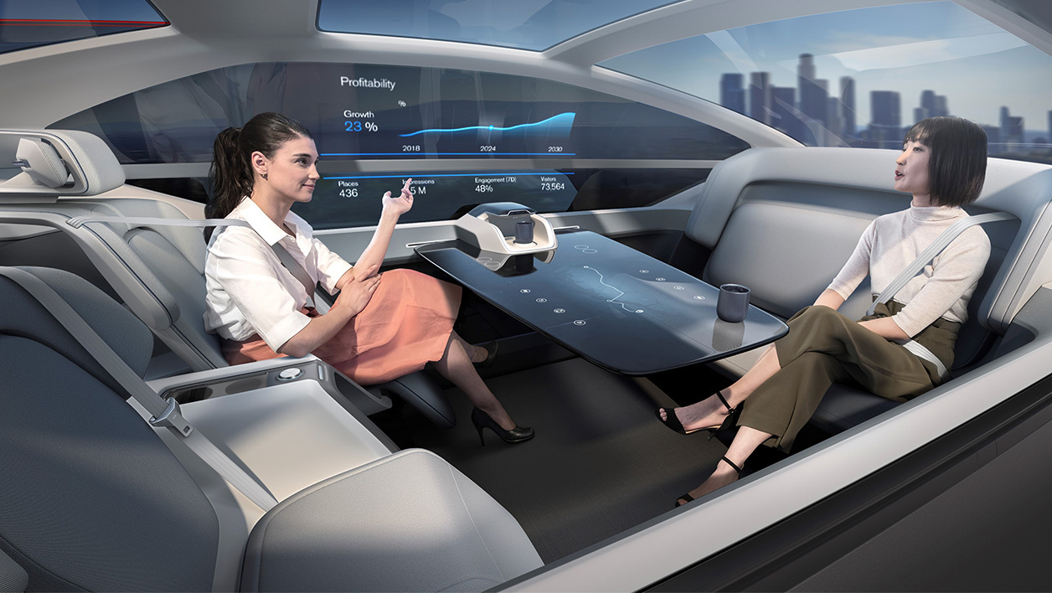
Summary
1) Introduction
2) Premises
3) autonomous car today
4) security / place of ethics
5)What’s futur of Autonome car ?
6) conclusion
7) Question

Slide 3
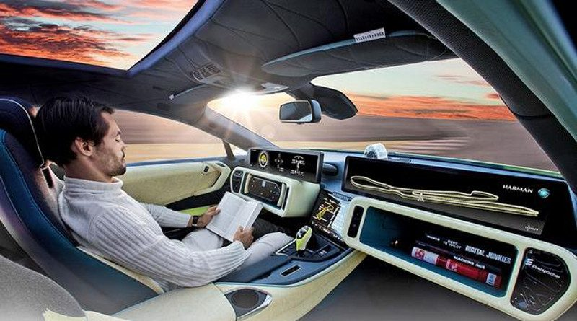
Introduction
What’s a autonome Car ?
Why autonome car is popular ?
Why is it expensive ?
Why every car constructor want make Autonome car ?

Slide 4
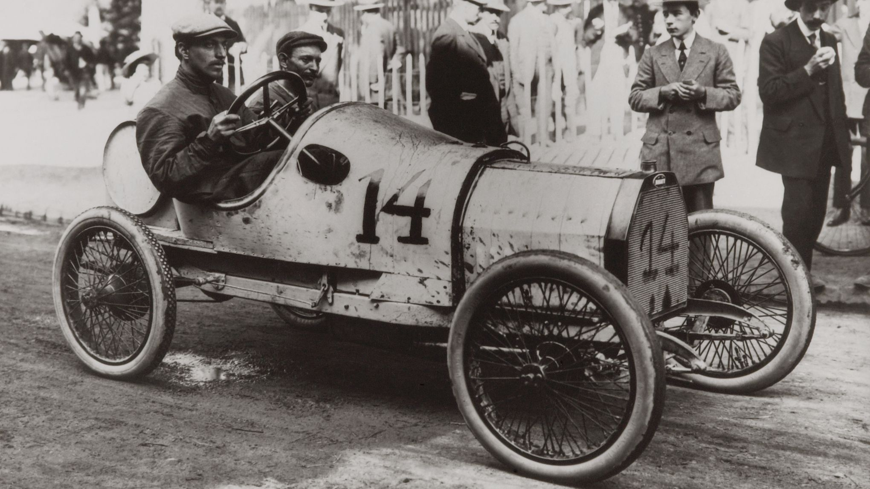
Premises
As with all areas, IT has taken a significant place in the automotive industry.
The constructor see a perspective of evolution for his cars.

Slide 5
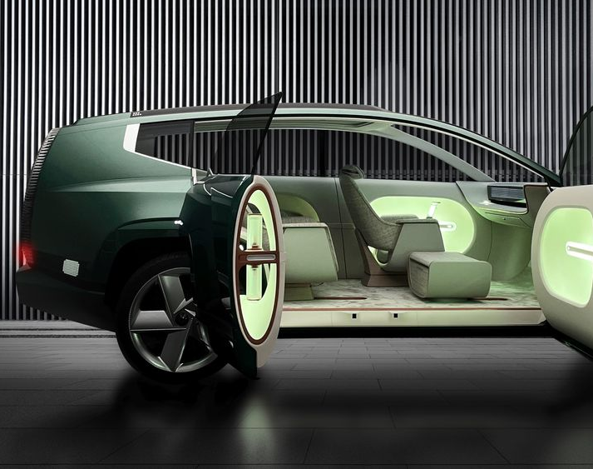
Autonomous car today
Wich technology cars are in autonomous car ?
why will they make your life easier ?
Who propose the best solution ?

Slide 6
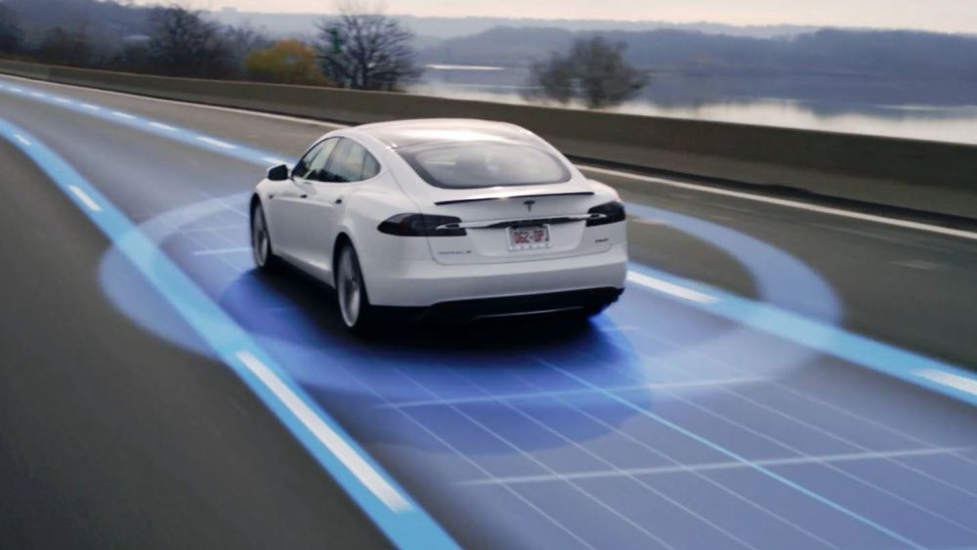
security / place of ethics
The security is the priority in autonomous car developement.
Which technology use a Self Driving car ?
Why do we mention the moral issue when we talk about self driving car ?

Slide 7
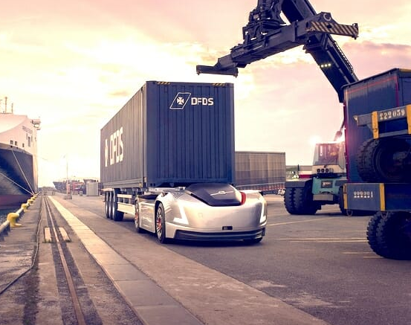
What’s futur of Autonome car ?
The Self Driving Car is going to take place in industries.
In Delivery
Taxi
Farming

Slide 8
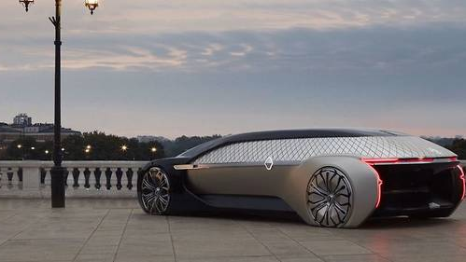
conclusion
We see that autonomous vehicles are increasingly present in every day
We need to be vigilant for its implementation

Slide 9
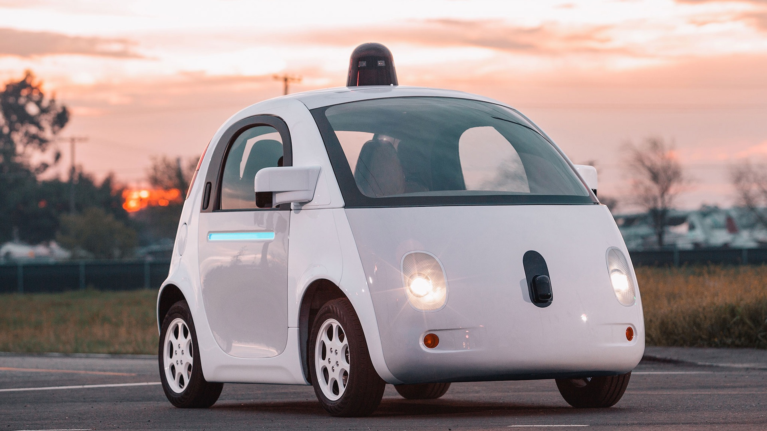
Question
Do you think the autonome car is the futur ?
Do you have some concerns or fear about autonomous cars

